Slide 1


Search => CSS Combinators , Transform (Skew ,scale) , perspective
search

Slide 2
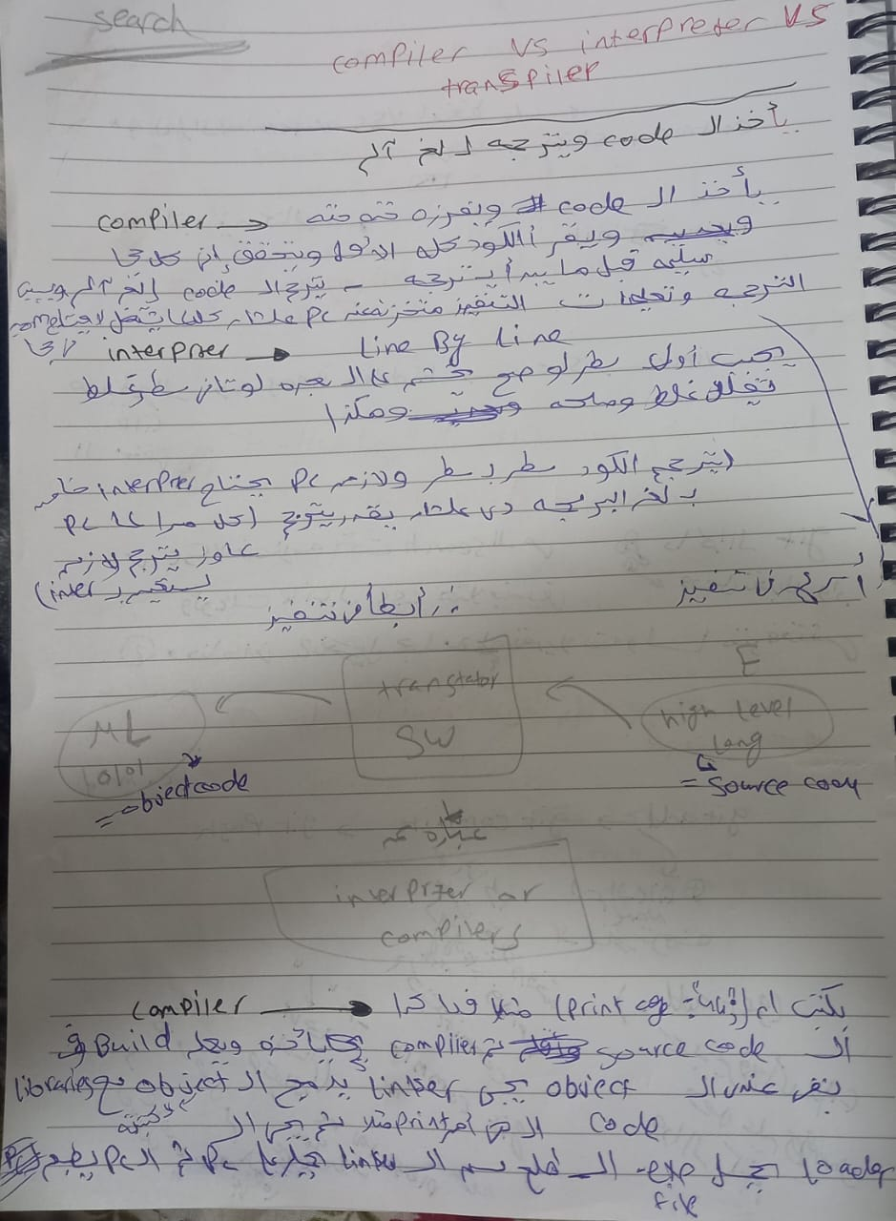

Slide 3
